Slide 1
Electronic Health Records
(EHR) Information System
Information Systems in Health Care (WS25/26)
Team: Aziz, Ramis, Batool
Deggendorf Institute of Technology

Slide 2
Presentation Overview
1. Introduction to EHR Systems
2. System Architecture & Design
3. Features & Functionality
4. Live Demonstration
5. Usability Evaluation (SUS)
6. Conclusion & Q&A

Slide 3
What is an Electronic Health Record?
An Electronic Health Record (EHR) is a digital version of a patient's paper chart containing:
• Medical and treatment history
• Diagnoses and medications
• Immunization dates
• Allergies and lab test results
• Real-time access for authorized users
Benefits:
✓ Improved Patient Care
✓ Enhanced Patient Safety
✓ Increased Efficiency
✓ Better Care Coordination
✓ Secure Data Storage

Slide 4
Our EHR System - Project Overview
Purpose:
Develop a comprehensive web-based EHR management system from a doctor's perspective for efficient patient information and health records management.
Key Objectives:
Complete patient lifecycle management
Comprehensive EHR record creation and management
Secure authentication and data protection
User-friendly interface with responsive design
Medical image upload and display

Slide 5
Technology Stack
Frontend
Backend
• HTML5
• CSS3
• Bootstrap 5.3.0
• JavaScript (ES6)
• PHP 7.4+
• MySQL 5.7+
• Apache Server
• WAMP/XAMPP
Architecture: Three-Tier (Presentation, Application, Data)
Security Features:
• Password Hashing (bcrypt)
• SQL Injection Prevention (Prepared Statements)
• XSS Protection (htmlspecialchars)
• Session Management with Timeout
• Brute Force Protection

Slide 6
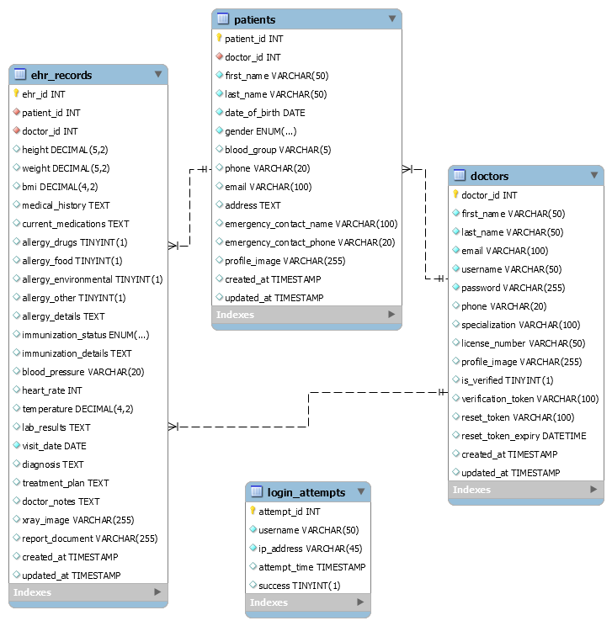
Database Architecture
doctors
patients
ehr_records
login_attempts
Doctor credentials
& profile data
Patient demographics
& contacts
Complete health records
& medical images
Security tracking
& brute force protection

Slide 7
System Features
👤
🏥
📋
Authentication
Patient Mgmt
EHR Records
Secure registration
& login system
Complete CRUD
operations
Comprehensive
health records
🔍
📊
📱
Search
Dashboard
Responsive
Quick patient
& record lookup
Statistics &
quick actions
Works on all
devices

Slide 8
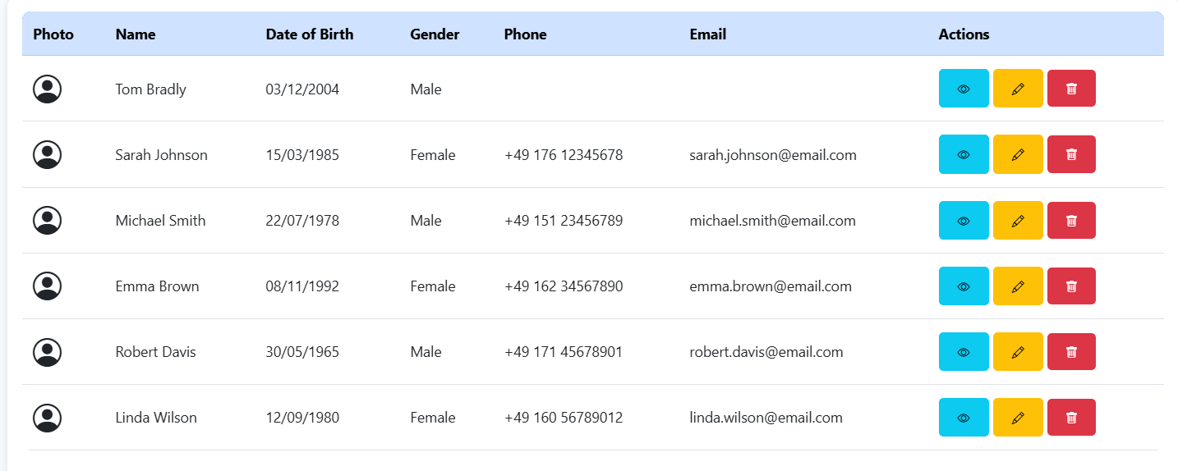
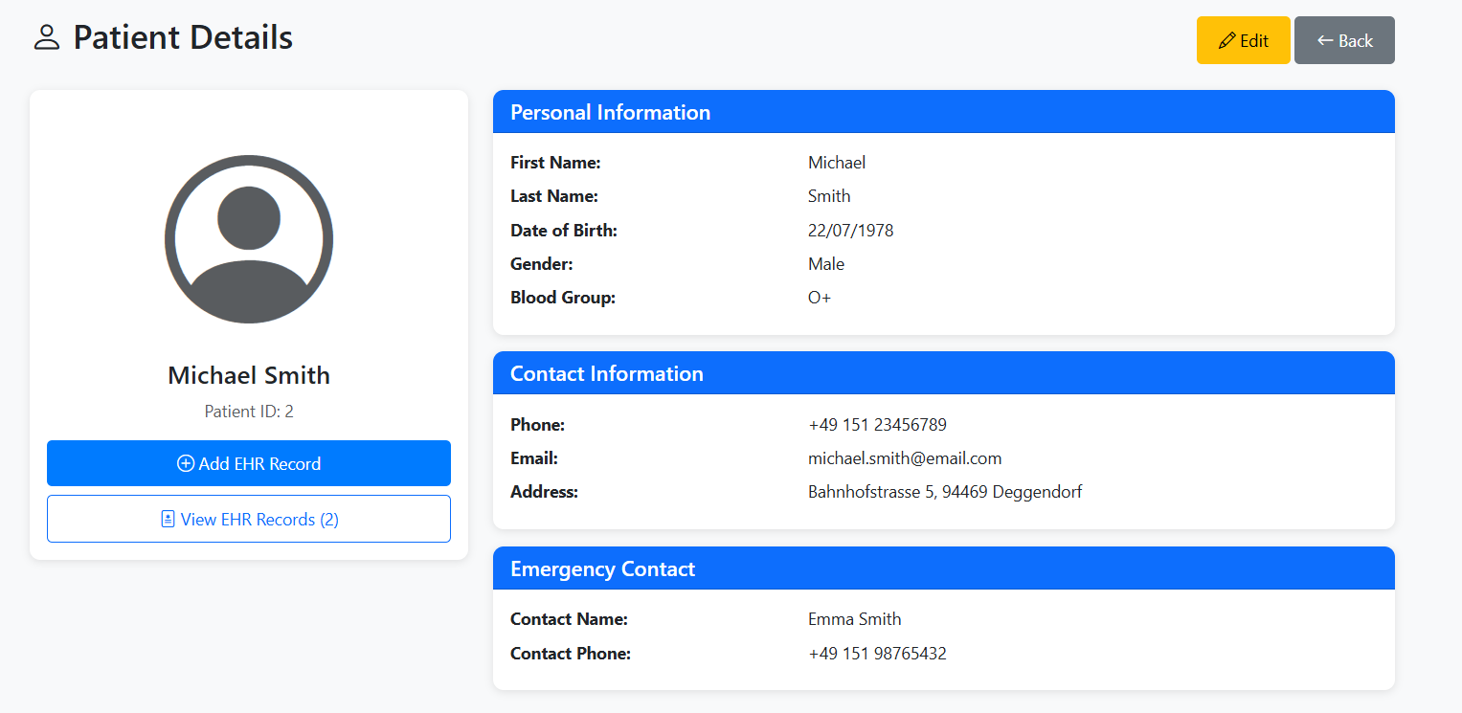
Patient Management Features
CRUD Operations:
✓ Create: Add new patients with profile pictures
✓ Read: View complete patient information
✓ Update: Edit patient details anytime
✓ Delete: Remove patient records securely
Additional Features:
• Real-time search functionality
• Emergency contact management
• Profile image upload
• Blood group tracking

Slide 9
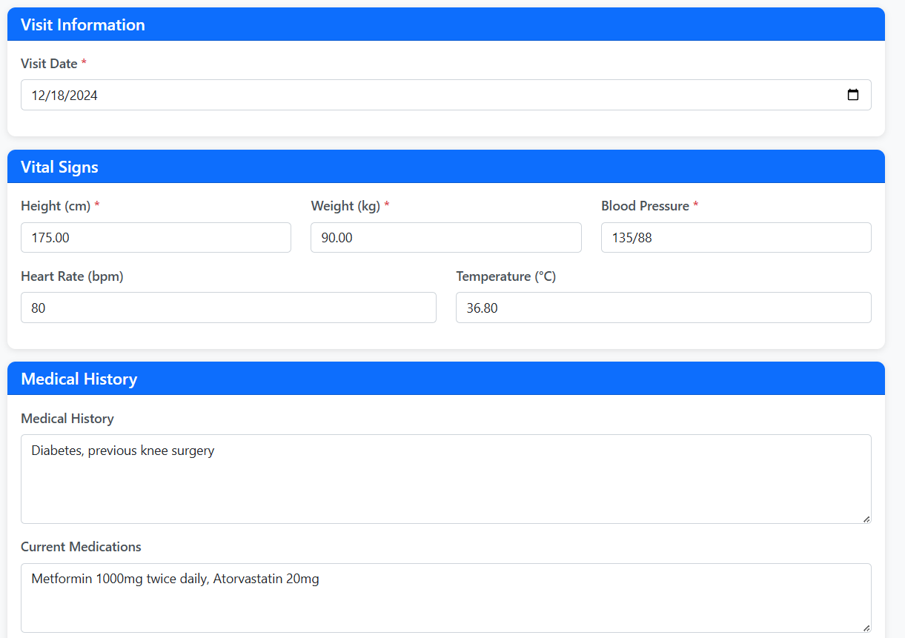
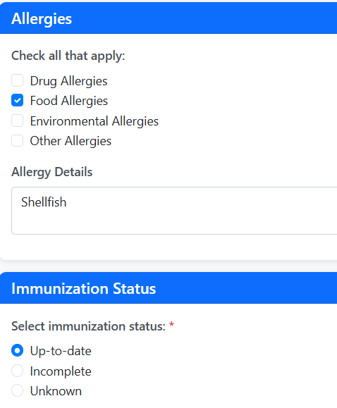
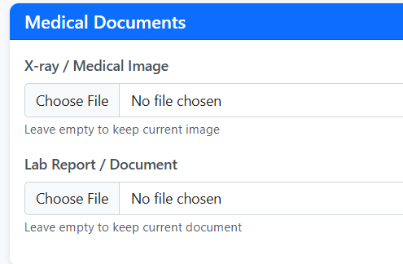
EHR Record Creation
Complete Form with All Required Input Types:
✓ Text Inputs (3+): Height, Weight, BP, Heart Rate, Temperature
✓ Checkbox: Allergies (Drugs, Food, Environmental, Other)
✓ Radio Buttons: Immunization Status (Up-to-date, Incomplete, Unknown)
✓ Date Input: Visit Date (with datepicker)
✓ Textarea: Medical History, Medications, Diagnosis, Treatment Plan, Notes
✓ Image Upload: X-rays, Lab Reports (max 5MB)

Slide 10
EHR Record Display & Management
Features:
• Complete vital signs display with visual formatting
• Medical images (X-rays, MRI) with zoom functionality
• Edit and delete capabilities
• Automatic BMI calculation
• Color-coded badges for allergies and immunization status

Slide 11
LIVE DEMONSTRATION
Let's see the system in action!
http://localhost/ehr-system/

Slide 12
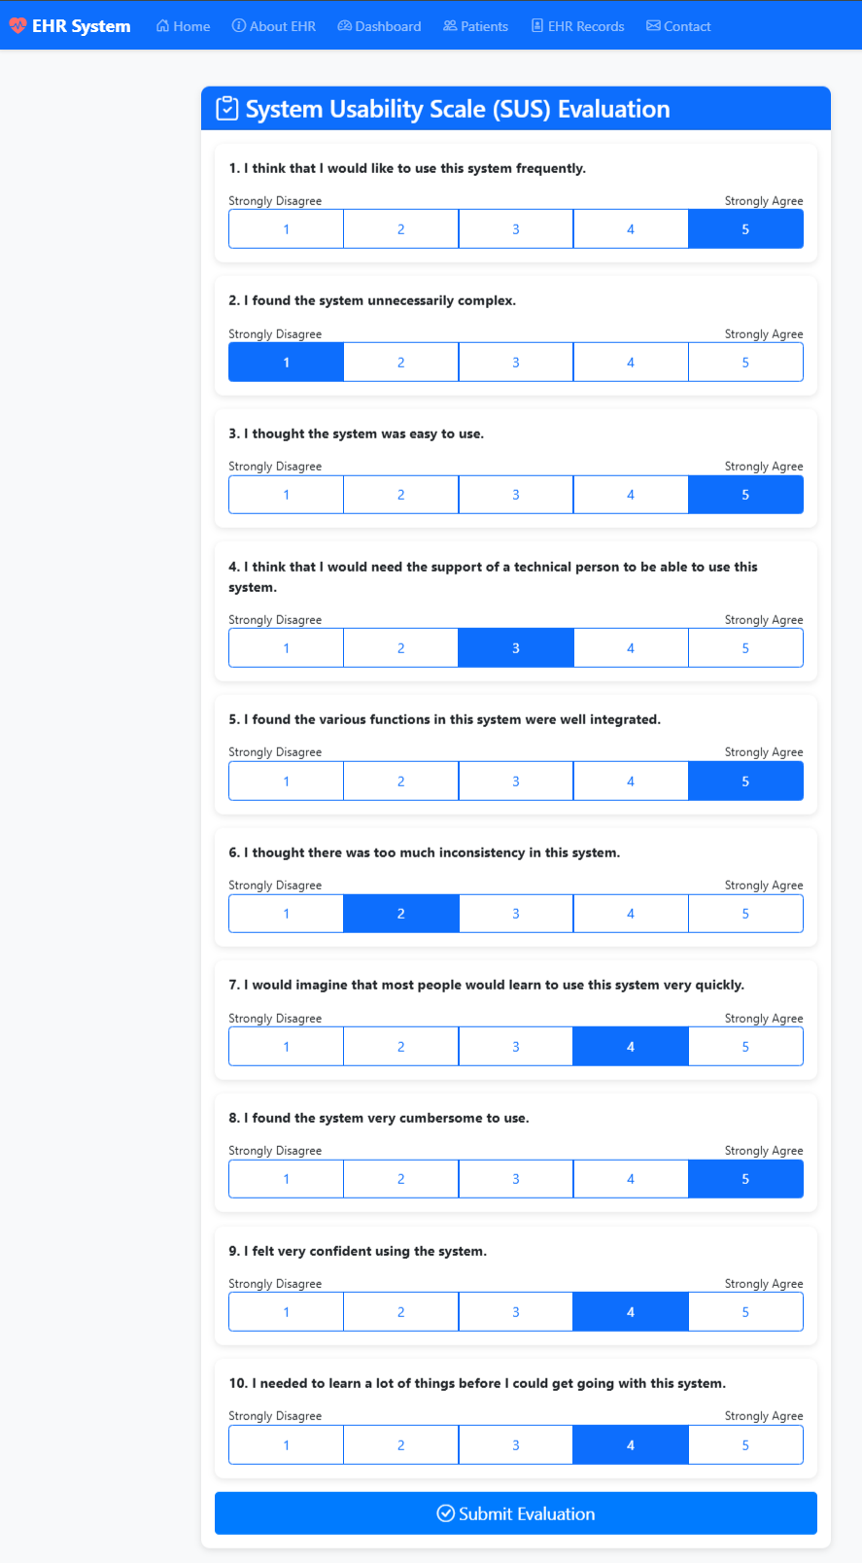
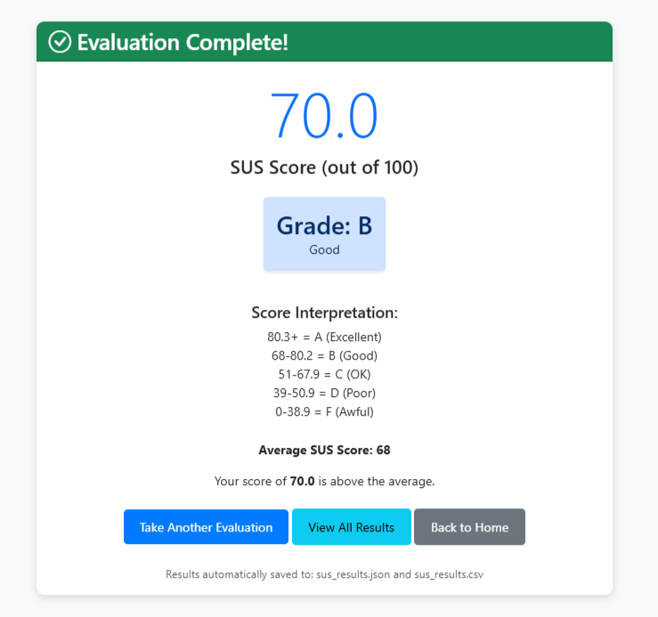
System Usability Scale (SUS) Evaluation
What is SUS?
A reliable, low-cost usability scale consisting of 10 questions with 5 response options (Strongly Disagree to Strongly Agree).
Score Calculation:
Benchmark: 68
Above 68 = Good Usability
Below 68 = Needs Improvement
• Odd items (1,3,5,7,9):
Score = Position - 1
• Even items (2,4,6,8,10):
Score = 5 - Position
• Sum all scores
• Multiply by 2.5

Slide 13
Our SUS Evaluation Results
Files auto-saved:
sus_results.json • sus_results.csv

Slide 14
Key Achievements
✓ Complete patient lifecycle management
✓ Comprehensive EHR records with all input types
✓ Secure authentication & data protection
✓ Medical image upload & display
✓ Responsive design (mobile, tablet, desktop)
✓ System usability evaluation (SUS)
✓ Auto-save evaluation results (JSON & Excel)
✓ Real-time search functionality
✓ Brute force protection

Slide 15
Future Enhancements
🔗 External lab system integration
📅 Appointment scheduling
💊 Prescription management
📊 Advanced analytics & reporting
🌐 Multi-language support
📧 Email notifications

Slide 16
Conclusion
✓ Successfully developed a comprehensive EHR system
The system provides:
• Complete patient management from doctor's perspective
• Comprehensive health record creation and maintenance
• Secure, user-friendly interface
• All required technical specifications met
• Positive usability evaluation results

Slide 17
Thank You!
Questions & Discussion
Team: Aziz, Ramis, Batool
Deggendorf Institute of Technology

